Slide 1
Wireless Device Security
Week 01 - Introduction

Slide 2
Wireless Device Security
What you will learn
The purpose of this unit is to allow learners to demonstrate an understanding of the processes and tools used to track, control, prevent and correct the security use of Wireless Local Area Networks (WLANs), access points, and wireless client systems.
This unit will cover the typical threats faced by wireless networks and how to find them, the mitigation procedures that can be used and the practical countermeasures that can be instigated.

Slide 3
Wireless Device Security
What you will learn
Knowledge and/or skills
AES encryption
WAP(Wireless Application Protocol)
WEP(Wired Equivalent Privacy)
WPA(Wi-Fi Protected Access)
WPA2
WPA2 enterprise
WPA2 enterprise with 802.1X authentication

Slide 4
Wireless Device Security
What you will learn
Knowledge and/or skills
Wireless fundamentals
Wired and wireless network threats
Physical security
Default passwords
Public open Wi-Fi
Service Set Identifier (SSID)
Wi-Fi spoofing
Rogue access points

Slide 5
Wireless Device Security
What you will learn
Knowledge and/or skills
Wireless network vulnerability scanning
Rogue AP detection
Wireless Intrusion Detection Systems (WIDS)
Wired network port security
Wireless network for personal or untrusted devices
Survey networks being broadcast, disabling unneeded networks
Filter wireless traffic
Bandwidth management to prevent denial of service attacks
Virtual Private Networks (VPN)

Slide 6
Wireless Device Security
Assessments for Wireless Device Securities
Multiple choice 20 questions(Week 10)
Configure a radius server(Week 5)
Detect and hack a wireless access point(Week 7)

Slide 7
Wireless Device Fundamentals
This presentation is to help gain familiarity with basic Wi-Fi concepts, terminology and functionality.
To provide an overview of how Radio Frequencies can be used to encode data, error with Wi-Fi signal propagation, and how to implement Wi-Fi channels when designing a WLAN.

Slide 8
What is Wi-Fi
Wi-Fi is not an acronym(Wireless fidelity!) a name created by the Wi-Fi Alliance.
It uses the manipulation of electromagnetic radiation to encode data. (Radio frequencies)
It is sometimes called “Wireless Ethernet” but this is wrong:
Wi-Fi has totally different framing than Ethernet(wired).
Totally different method for detecting collisions.

Slide 9
Wi-Fi Standardisation
Created by the IEEE work group to 802.11 standard.
WiFi standardisation is broken into two sub-categories
MAC (Media Access Control Layer)
PHY (Physical Layer)
Each letter after 802.11 represents an amendment to the original standard:
Original standard created 802.11 = 1997
Next amendment 802.11b = 1999
And so on……

Slide 10
Wireless
A wireless LAN is an 802 LAN.
Transmits data over the air vs. data over the wire
Looks like a wired network to the user
Defines physical and data link layer
Uses MAC addresses
The same protocols/applications run over both WLANs and LANs.
IP (network layer)
IPSec VPNs (IP-based)
Web, FTP, SNMP (applications)

Slide 11
802.11 Amendment | Frequency (GHz) | Max Data Rate | Date | Notes
802.11 | 2.4 | 2 Mbps | 1997
802.11a | 5 | 54 Mbps | 1999 | To expensive
802.11b | 2.4 | 11 Mbps | 1999 | Used standard
802.11g | 2.4 | 54 Mbps | 2003
802.11n | 2.4/5 | 600Mbps | 2009
802.11ac | 5 | 7Gbps | 2013 | Known as “Wi-Fi5”
802.11ax | 2.4/5 | 14Gbps | 2020 (Estimated) | Known as “Wi-Fi6”
Each amendment is an update and the previous clause is added to the next

Slide 12
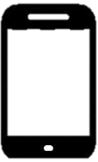

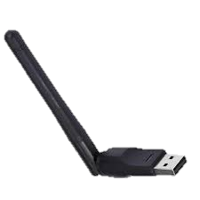
Wi-Fi Wireless Local Area Network
Components
Clients
Clients are the end point for data
Wi-Fi does not pass through clients
Wi-Fi Client differentiations
Power source
Battery
AC
Quantity and types of antennas
More antennas the faster the data rate
Type of transceivers the client has.
Hardware that can transmit and receive data

Slide 13
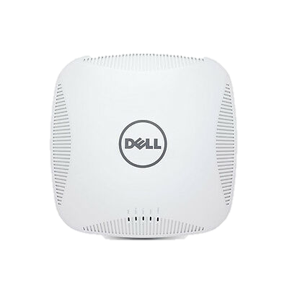
Wi-Fi Wireless LAN
Components
Access Points(AP’s)
Consolidation point for Clients
Creates Wireless Bridges and Wired domains
AP differentiators
Centrally Managed
Lightweight centrally managed offering basic configurations
Individually Managed
Autonomous
Command line management capabilities
Quantities and types of receivers (2.4Ghz, 5Ghz)
Quantities and types of antennas

Slide 14
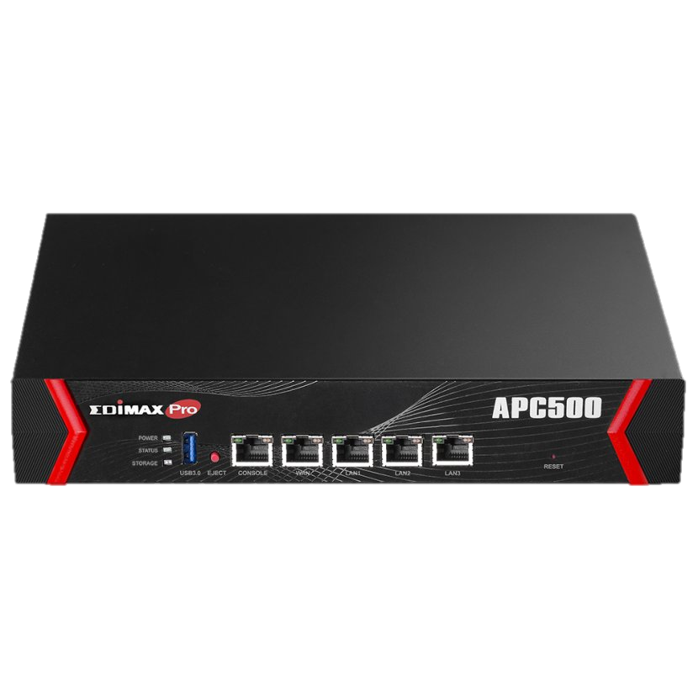
Wi-Fi Wireless LAN
Components
Controllers
Central point of management for groups of Access Points
Control Wi-Fi access for Clients
The uses of a controller
Discover all IP addresses on the system and to what AP they are connected.
Ensure that all access points have the same software levels.
Enforces standard configuration to all AP’s in the system.
Client permission status and what level they have for the system.(Access Control).

Slide 15
Wi-Fi Wireless LAN
Types of Wi-Fi Networks
AD-Hoc
Wi-Fi Clients communicate directly, point-to-point.
No access points involved
Infrequently used
No network infrastructure available
Remote area
Military battle field where the infrastructure has been destroyed or become insecure
Emergency: “When properly combined with satellite-based information delivery, MANET technology can provide an extremely flexible method for establishing communications for fire/safety/rescue operations or other scenarios requiring rapidly-deployable communications with survivable, efficient dynamic networking” (RFC 2501)

Slide 16
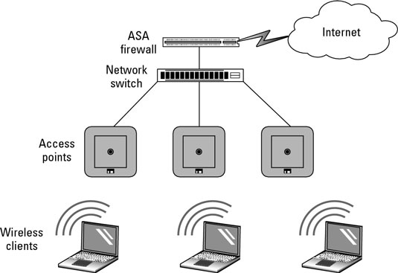
Wi-Fi Wireless LAN
Types of Wi-Fi Networks
Infrastructure
Integration of an Access Point to co-ordinate Wi-Fi usage among multiple Clients
In Infrastructure mode, an AP is connected to a wired infrastructure (such as Ethernet) and all of the wireless devices communicate with the AP. Even if two wireless devices are located right next to each other, all communication between the devices occurs through an AP.
When using Infrastructure mode, a collection of wireless devices connected to an AP is referred to as a Basic Service Set (BSS).

Slide 17
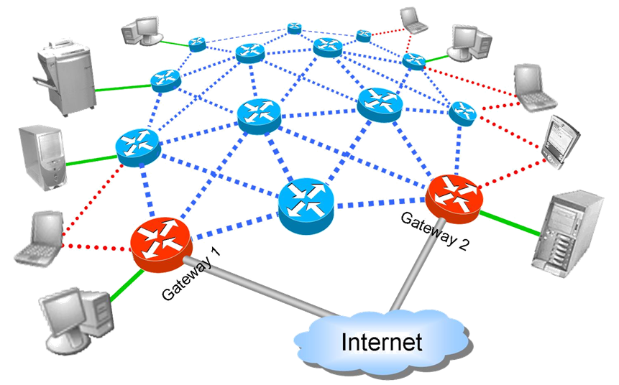
Wi-Fi Wireless LAN
Types of Wi-Fi Networks
Mesh
Access points are daisy changed together
Clients connect to one point at a time
Clients data is relayed from one AP to another until it reaches a wired network to continue its determined path
When is Mesh utilised
Outdoor environments
Geographical areas where there is a lack of wired Ethernet connectivity
A true mesh is a network with more than three nodes having a connection schema that can process a communication link through more than two hops.

Slide 18
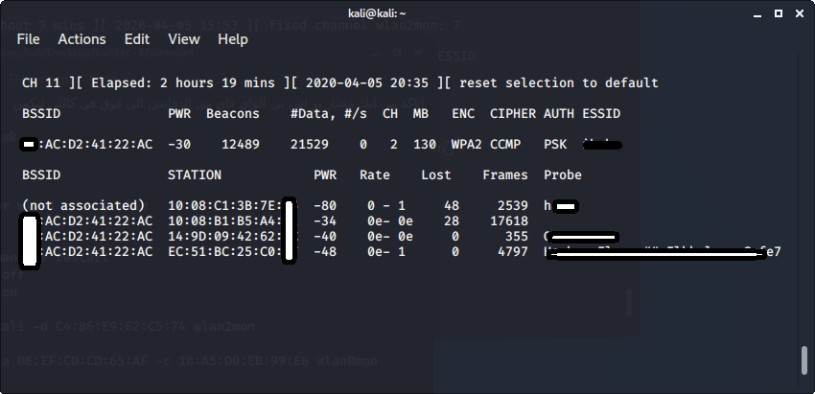
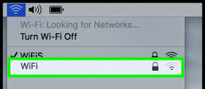
Wi-Fi Definitions
BSS
Basis Service Set a single access point and its coverage area
Radio networks generally posses a cellular structure, larger networks are subdivided into discrete radio cells. A cell corresponds to the area covered by the range of the radio signals of a particular sender. These ranges again depend on the antennas employed.
BSSID
ID MAC address of the access point, constant Wi-Fi messages announcing the AP’s MAC address.
SSID
Service Set Identifier
Configurable name of the WLAN

Slide 19
Wi-Fi Definitions
Service Set Identifier (SSID):
Network name
32 octets long
One network (ESS or Independent Basic Service Set (IBSS)) has one SSID
There are two possible ways for the client to know the SSID of the network. Either the SSID is told to the client by the AP (often called Open Network mode), or the SSID must be known by the client via some other method, such as being pre-programmed into the client device by the system administrator (often called Closed Network mode).
Basic Service Set Identifier (BSSID)
“cell identifier”
6 octets long (MAC address format)
One BSS has one SSID
Value of BSSID is the same as the MAC address of the radio in the Access-Point

Slide 20
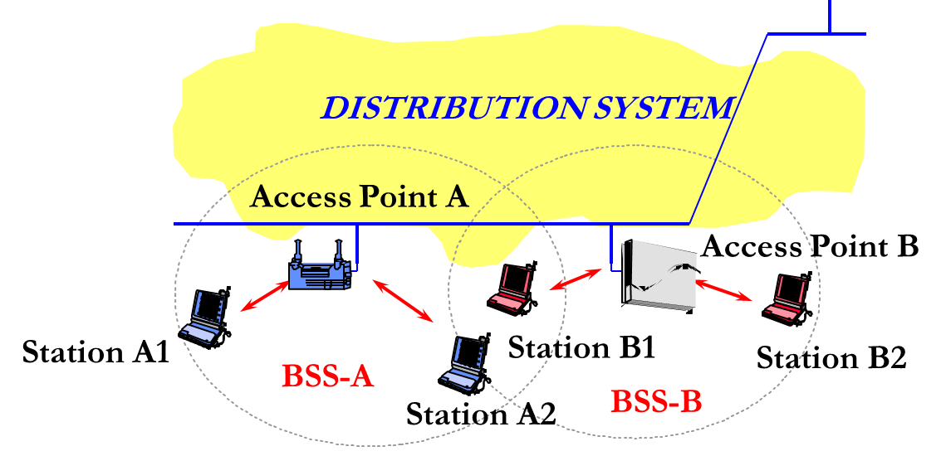
DS = Distribution System
Wired network connect to the wireless networks
ESS = Extended Service Set = interconnection of several BSSs via DS
A collection of access points connected to the same Distribution System

Slide 21
Wi-Fi Wireless Frequencies
What is a frequency?
It is a measurement of how often something changes over a given time interval, the name chosen to display this measurement was HERTZ. The HERTZ measurement is calculated using one second intervals.
1Hz = 1 change/cycle per second
Measurement of radio frequencies are not measured in one’s but millions or billions per second!
MHz = Millions
GHz = Billions

Slide 22
Electro Magnetic Radiation
Like the name says EMR has both electrical and magnetic properties
In the display bellow electron passing through a wire from two connected batteries emit a radiation field at 90 degree angles
Radiation emitted outwards from the movement of electrons
Battery
Battery
Electrons going back and forward

Slide 23
Wi-Fi Wireless Frequencies
Unlike other wireless activities, such as radio or TV broadcasting, we do not need to purchase frequencies or pay a monthly service fee to use the airways for Wi-Fi.
Requires no medium to propagate.
It can even go through the vacuum of space, scientists use this ability to detect new solar systems in the universe.
EMR has a detectable waveform, known as oscillations.
The cycle of the wave form is measured in HERTZ.
Radio frequency is the measurement of the oscillation of EMR.

Slide 24
Wireless Frequencies
ISM Bands
EMR oscillates at certain frequencies
All EMR frequencies have assigned labels
Audio AM Radio Broadcast TV
ISM (Industrial, Scientific and Medical)
Extremely Low(Elf) | Very Low | Low | Medium | High | Very High | Ultra High | Infrared | Visible Light | Ultra violet | X-rays | Gamma Rays
ISM
902 - 928
ISM
2.4 – 2.5GHz
ISM
5GHz

Slide 25
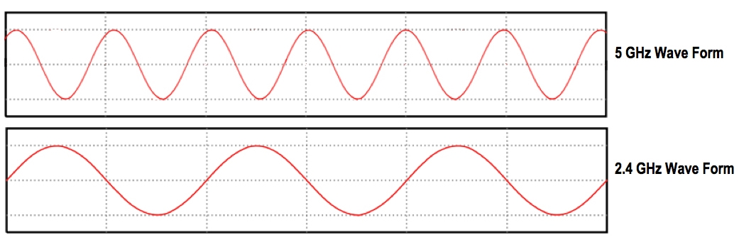
Wireless Frequencies
Modulation
Radio frequencies(EMR) has several properties, these can be artificially changed to encode data.
The process is called “Modulation”
The greater the frequency the more data can be encoded into a Wi-Fi signal.
The FM radio that we listen to uses a slower frequency of MHz unlike Wi-Fi that utilises GHz
Radio Forth 97.3MHz oscillates at over 97 million times a second.

Slide 26
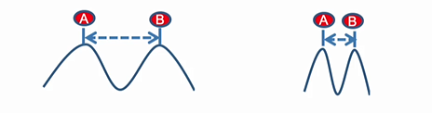
Wavelengths
Measured in metres
Wavelength is related to frequency
The higher the frequency, the shorter the wavelength
The longer the wavelength, the better the signal propagates through obstacles to Wi-Fi.
5GHz is faster but if you have obstacles between you AP and Client 2.4GHz could be more advantageous.

Slide 27
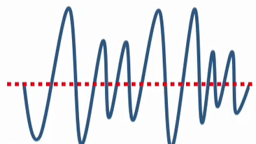
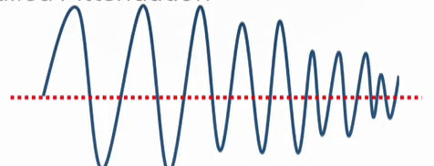
Amplitude
Strength of a signal, measured through power.
Amplitude can be modulated to encode data.
RF amplitude weakens greatly over distance and as it passes through objects.
This a called Attenuation

Slide 28
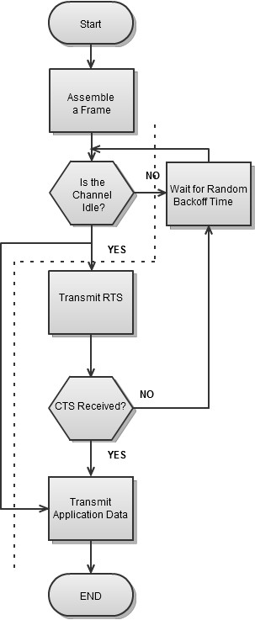
Carrier Sense Multiple Access/Collision Avoidance
The access to a radio channel in systems according to the 802.11 standard is controlled by a random procedure called Carrier Sense Multiple Access with Collision Avoidance (CSMA/CA)
This technique permits the simultaneous access of several devices to the carrier medium.
The working of CSMA/CA can be described in the following way:
When a station wants to send a data packet it checks the carrier medium,
whether other signals are present. If it cannot detect any signal it waits for a short random time interval (inter-frame spacing) and then checks again, if the medium is clean.
If this is the case the data packet is transmitted.
The station having received the packet checks its integrity. If everything is okay, a receipt is sent after another short inter-frame spacing. If the sending station does not receive an acknowledgement, it is assumed that a collision with a different data packet has taken place. The station waits again for a random time interval and then tries again.

Slide 29
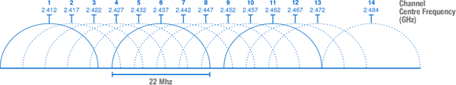
What are overlapping channels?
You may be wondering: If an 802.11b channel is 22 MHz wide and operates in a band of frequencies that is 83.5 MHz wide, then how do we fit in 11 channels?
The answer is that we “cheat.” Each centre frequency is spaced only 5 MHz apart, meaning that each channel overlaps with other, adjacent channels.
The only way to have truly non-overlapping (and noninterfering) channels is to use Channels 1, 6, and 11. That’s why you sometimes hear people say that 802.11 only has three “real” channels.

